Slide 1
LANGUAGE AND WRITING SKILLS
BY- VIDISHA KASHYAP

Slide 2
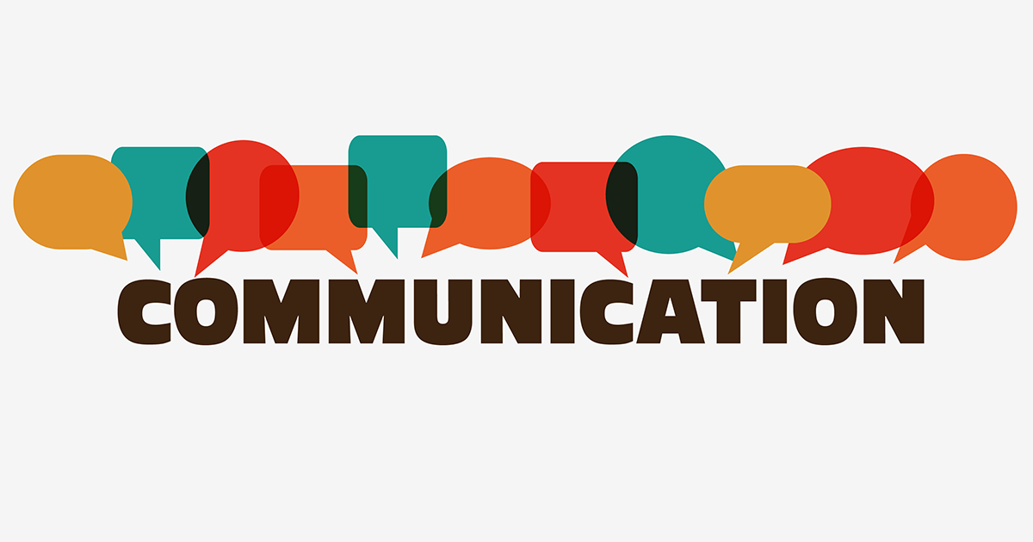
UNIT 1 ..

Slide 3
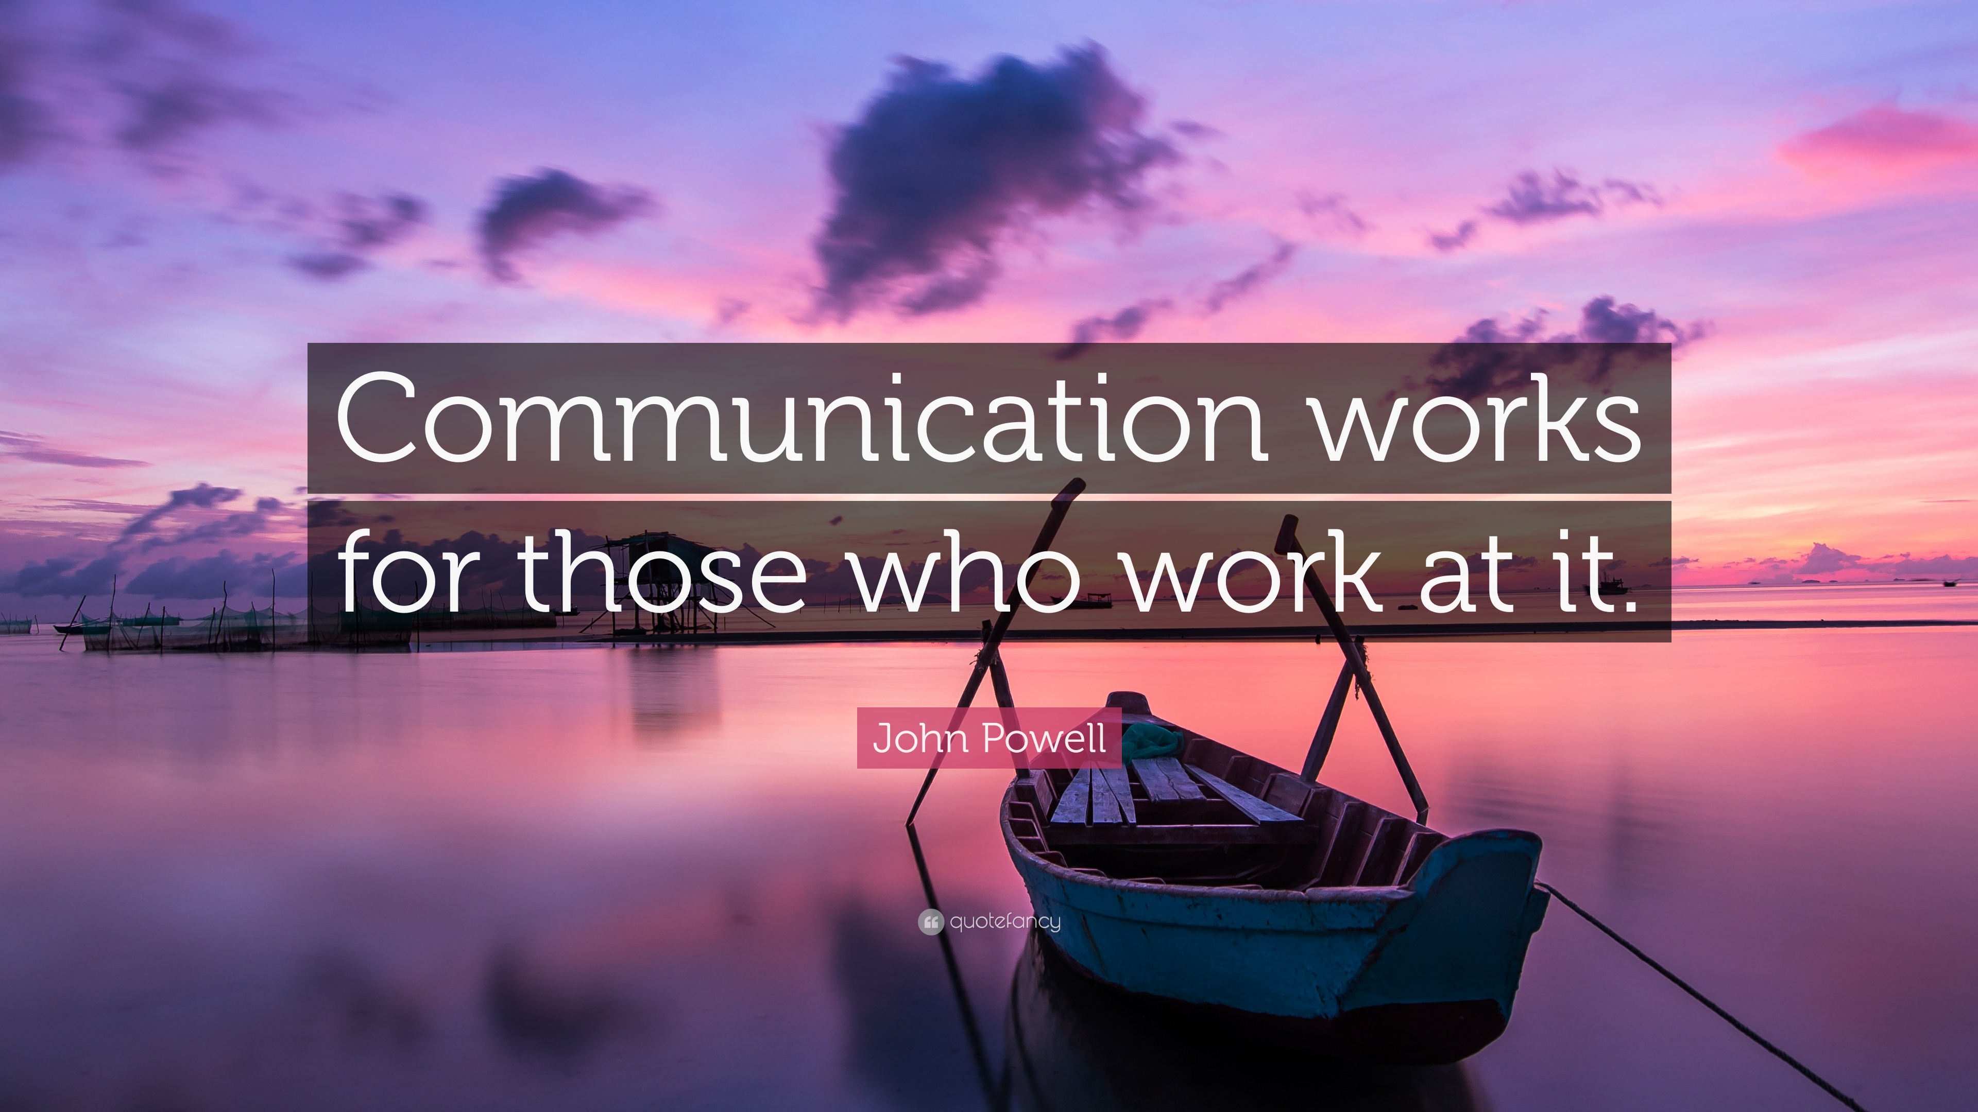

Slide 4
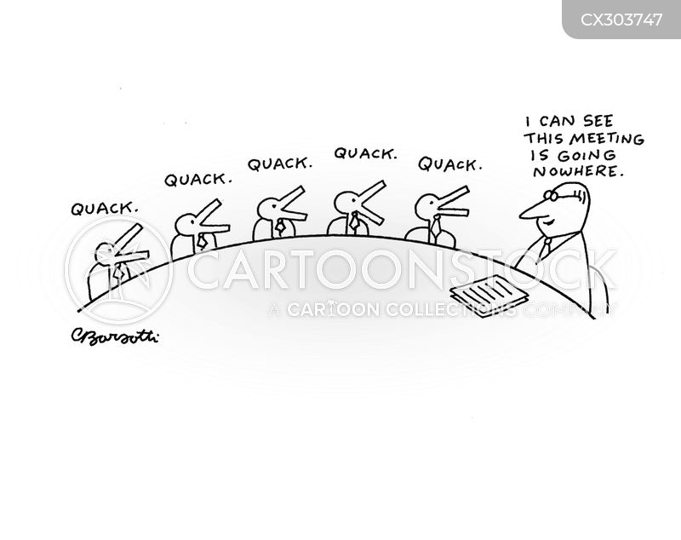

Slide 5
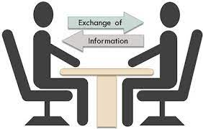

Communication as a skill:
What is communication?
What it does?
Why is Communication skill important?
Good communication skills in life will ensure everyone around you understands you and you understand them.
You will be confident and assertive.
Less misunderstanding.
You will rarely have to face issues that comes with poor communication
Easy to make and keep friends.

Slide 6
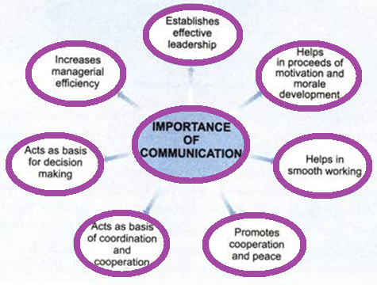

Slide 7

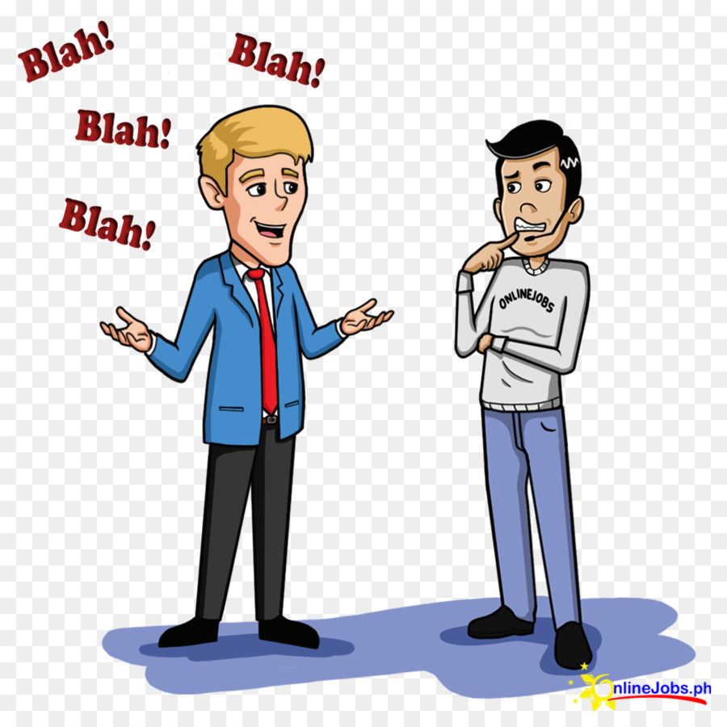
Introduction/ Communication..
GROUP DISCUSSION
How to IMPROVE Communication Skills?

Slide 8
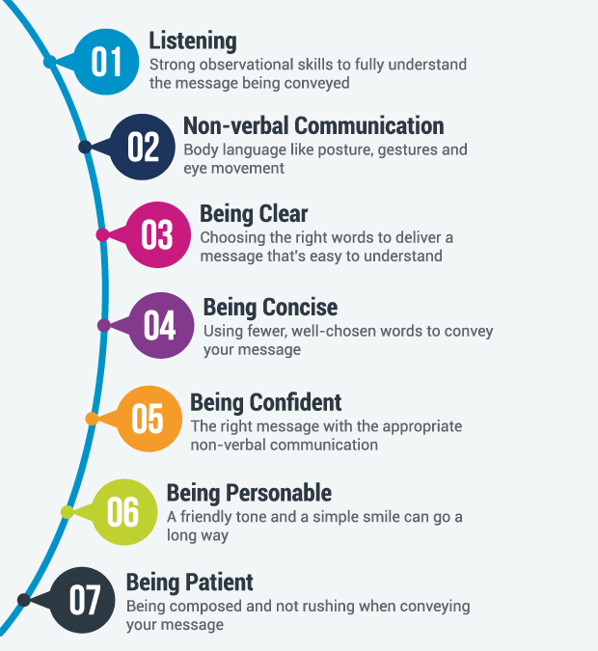


Slide 9
Types of communication skills

Slide 10
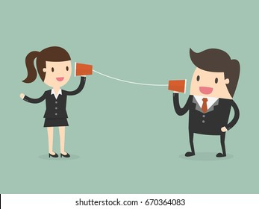

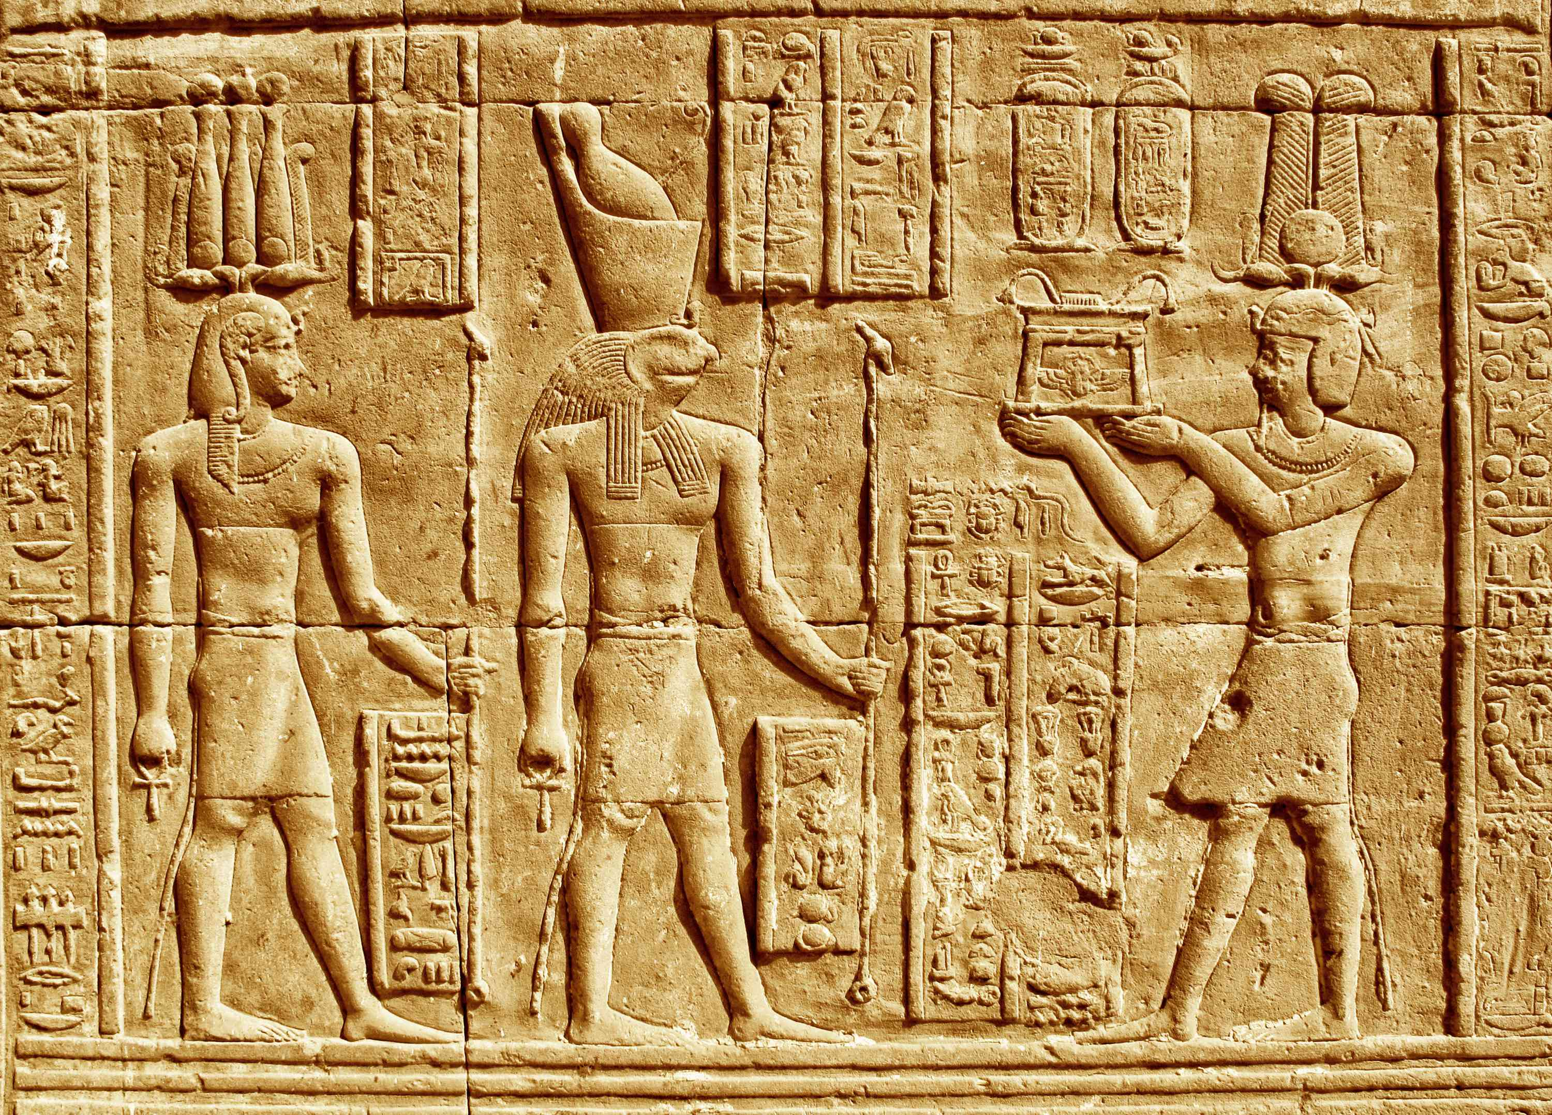


Slide 11
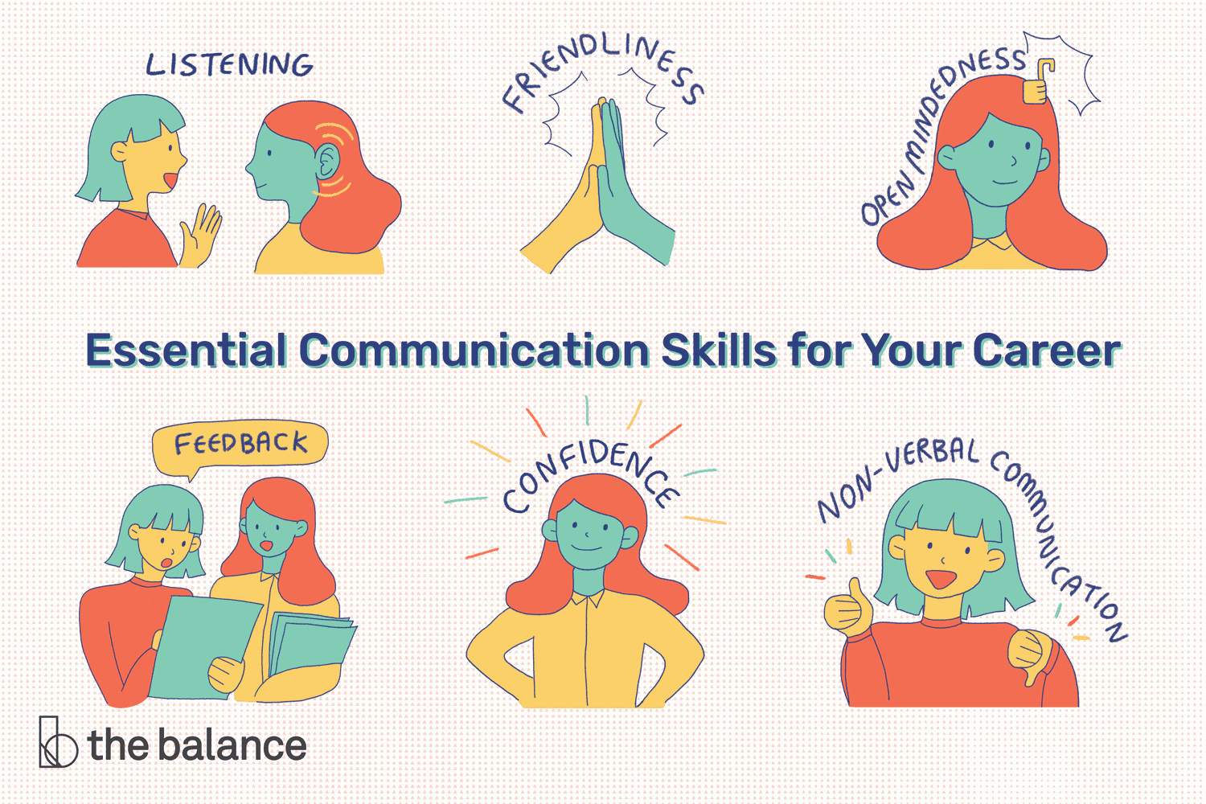

Slide 12
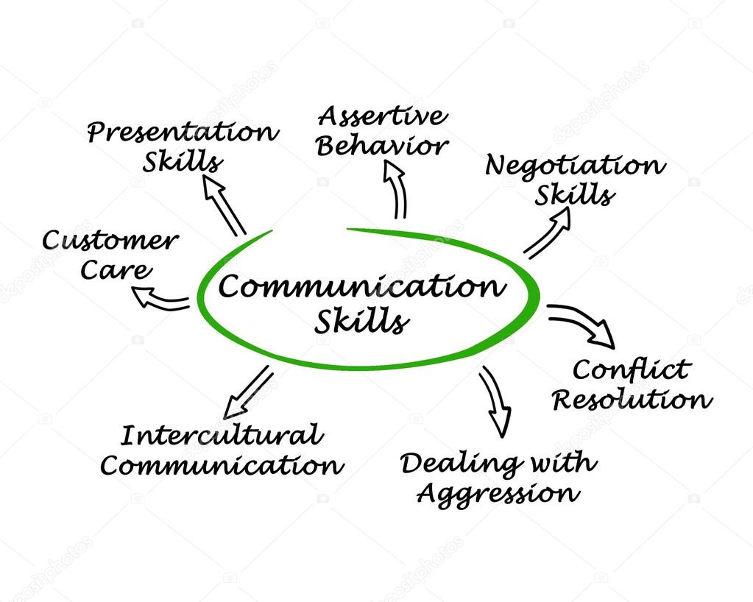

Slide 13
Components Of Communication
Understanding the process of communication
Barriers to Communication/ Factors affecting communication

Slide 14
KEY STAGES IN THE
COMMUNICATION CYCLE

Slide 15
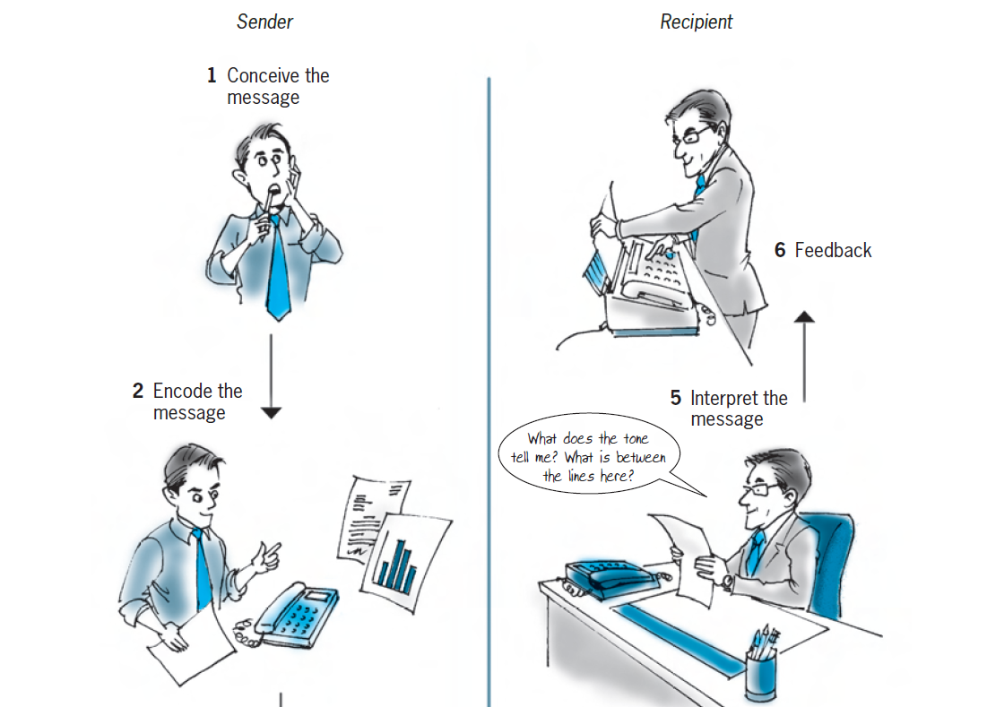

Slide 16
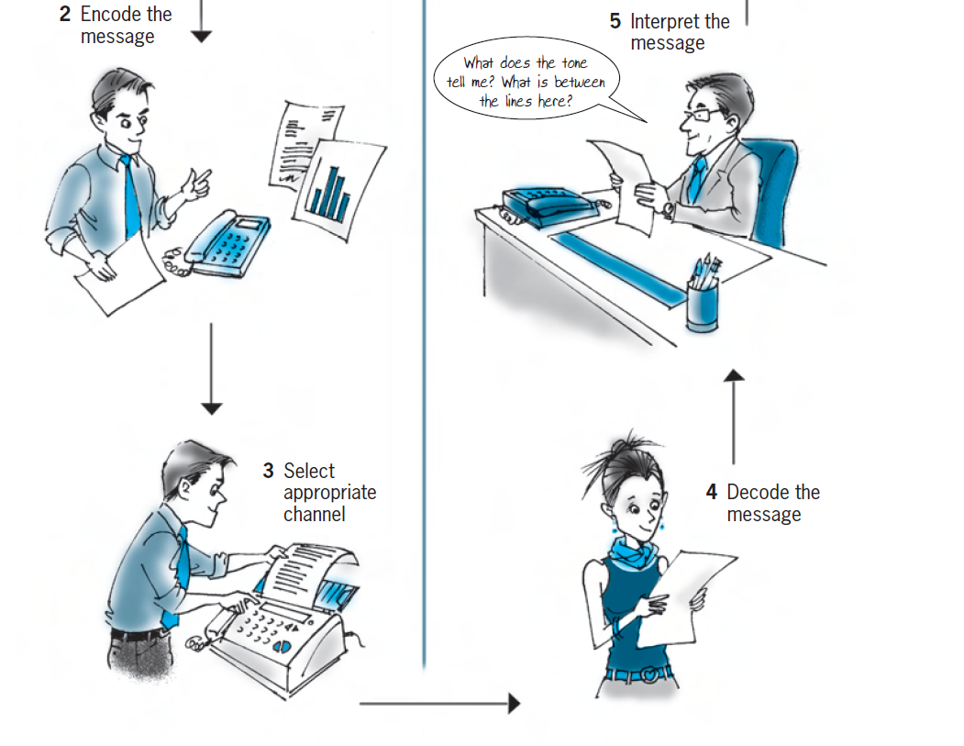

Slide 17
SENDER | RECIPIENT
Conceive the message | Decode the message
Encode the message | Interpret the message
Select the appropriate channel | Feedback

Slide 18

Choosing the channel of communication
The channel (or means) that is chosen to send a message is very important.
The channel chosen can influence the message and how it is interpreted by the recipient.
Cost
Confidentiality
Safety and security
Influence
Urgency
Distance
Time of day
Written record
Recipient

Slide 19

7 C’s of Communication
Completeness
Conciseness
Consideration
Clarity
Concreteness
Courtesy
Correctness

Slide 20
EFFECTIVE COMMUNICATION
What is effective communication?
Effective communication is ensuring that your message is completely understood.
SEVEN STEPS TO EFFECTIVE COMMUNICATION

Slide 21
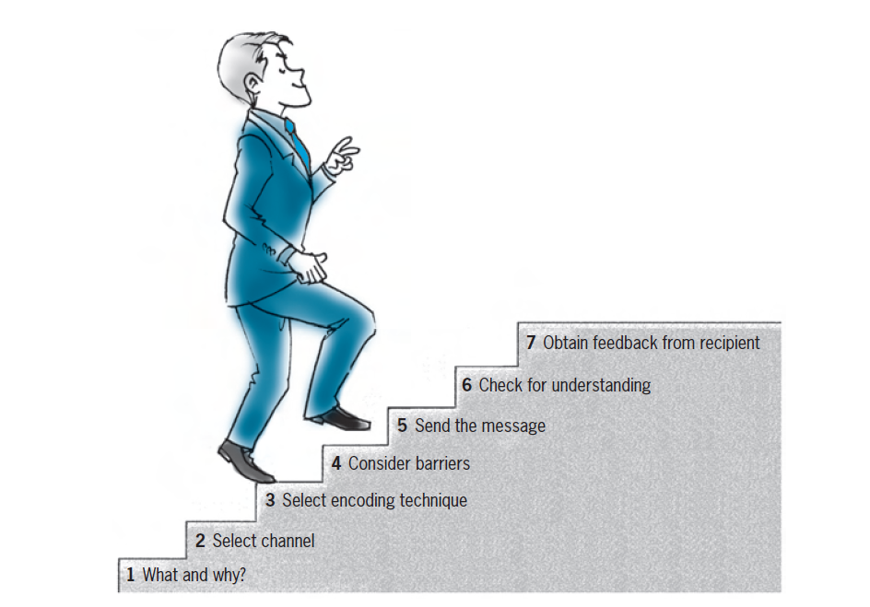

Slide 22

BENEFITS OF EFFECTIVE COMMUNICATION:
The most successful organizations understand that if they have to be successful in today’s business world, good communication at all levels is essential.
Stronger decision-making and problem-solving
Upturn in productivity
Convincing and compelling corporate materials
Clearer, more streamlined workflow
Enhanced professional image
Sound business relationships
Successful response ensured
SUCCESS

Slide 23

Need for Effective Communication in English for Engineers
Engineering communication skills are essential for presenting concepts and designs. Engineers with the ability to clearly communicate can confidently present their ideas to decision-makers in presentations, meetings, and reports.

Slide 24
Why English language is important for engineers?
While the engineers work, they need to communicate for self-expression. For power-packed expression, English language helps a lot with its vocabulary and simplicity in use. The engineers are able to drive the gist of their communication with a modicum of vocabulary that could help in making an effective speech.
What is the importance of communication in computer engineering?
The ability to write and speak well when applying for grants, fellowships and industry jobs is critical for engineers – they need to be able to translate their technical knowledge into lay terms and promote their skill set.

Slide 25
Types of noise during the communication process:
Psychological Noise : This type of noise interferes with communication between the sender and receiver because of personal barriers.
Physical Noise: Physical noise describes external distractions in your workplace.
Environmental noise: Environmental noise makes it difficult to hear or concentrate on a message, for example, noise from a construction site or passing traffic.
Semantic noise: Semantic noise is interference on the sender's end. This could be because of technical issues or poor communication skills. To communicate a message clearly, it is important to avoid jargon and ambiguous language when writing.
Similarly, speaking clearly in a relaxed and confident tone can communicate your point more effectively.

Slide 26
Using Oral Channels | Using Written Channels | Using Electronic Channels
When message is fairly simple. • Immediate response is needed. • When there is no need of permanent record • For encouraging interaction in problem-solving or decision-making • When there is need to read the recipient’s body language. • When there is need to hear the tone of recipient’s response. • When message being delivered has an emotional factor. | When message is fairly detailed or requires careful planning. • When there is no need of immediate response. • When permanent, written record is needed. • When distortion has to minimized that often occurs when messages are passed orally from person to person. • When there is no need of immediate interaction with the audience. • When messages being delivered has no emotional factor. | • When speed is important. • When time zones differs. • When you are physically separated from your audience.

Slide 27
SUCCESSFUL COMMUNICATION
1 Read. Extend your knowledge of language by reading.
2 Listen intelligently. Communication is a two-way process. Listening is just as important as speaking. Similarly, try reading your written message as if you were the recipient, and consider if it will be effective.
3 Think and plan. Think before you speak or write. Plan all your communications carefully, whether oral or written.
4 Use appropriate language. Use clear, simple language, and appreciate the same used by others.
5 Be open-minded. Consider other people’s viewpoints, be willing to adapt and change methods or procedures if necessary.
6 Select appropriate media. Consider carefully the method to be used for communicating your message. It should be appropriate to the desired objective.
7 Time your communication appropriately. Consider the best time for the communication and how long it should be.
8 Use appropriate language. Use words which are relevant to the topic and which will be understood by the recipient.
9 Obtain feedback. Obtain feedback to ensure that the communication was effective.
10 Aim high. Set and maintain high standards in all your methods of communication, both in terms of language and presentation.

Slide 28


